Slide 1
Virtual Memory

Slide 2
Virtual Memory
Virtual memory is a technique that allows the execution of processes that are not completely in memory.
Virtual memory abstracts main memory into an extremely large, uniform array of storage, separating logical memory as viewed by the user from physical memory.
This technique frees programmers from the concerns of memory-storage limitations.

Slide 3
Virtual Memory
Most code/data isn't needed at any instant, or even within a finite time - we can bring it in only as needed.
Arrays, lists, and tables are often allocated more memory than they actually need. An array may be declared 100 by 100 elements, even though it is seldom larger than 10 by 10 elements.
An assembler symbol table may have room for 3,000 symbols, although the average program has less than 200 symbols.

Slide 4
Demand Paging
When a process first executes ,the system loads into main memory the page that contains its first instruction.
After that the system loads a page from secondary storage to main memory only when the process explicitly references that page
This technique is known as demand paging and is commonly used in virtual
A demand-paging system is similar to a paging system with swapping
When we want to execute a process, we swap it into memory. Rather than swapping the entire process into memory, however, we use a lazy swapper or pager

Slide 5
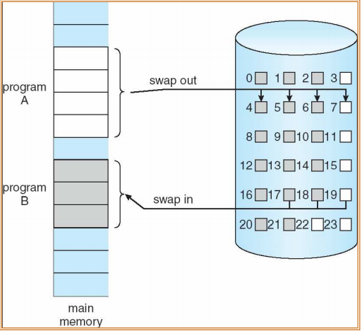

Slide 6
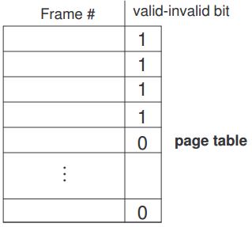
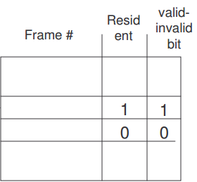
Page table requires a "resident“ bit showing that page is/isn't in memory. It uses "valid" bit to indicate residency. An "invalid" page is that way because a legal page isn't resident or because the address is illegal.
It makes more sense to have two bits – one indicating that the page is legal (valid) and a second to show that the page is in memory.

Slide 7
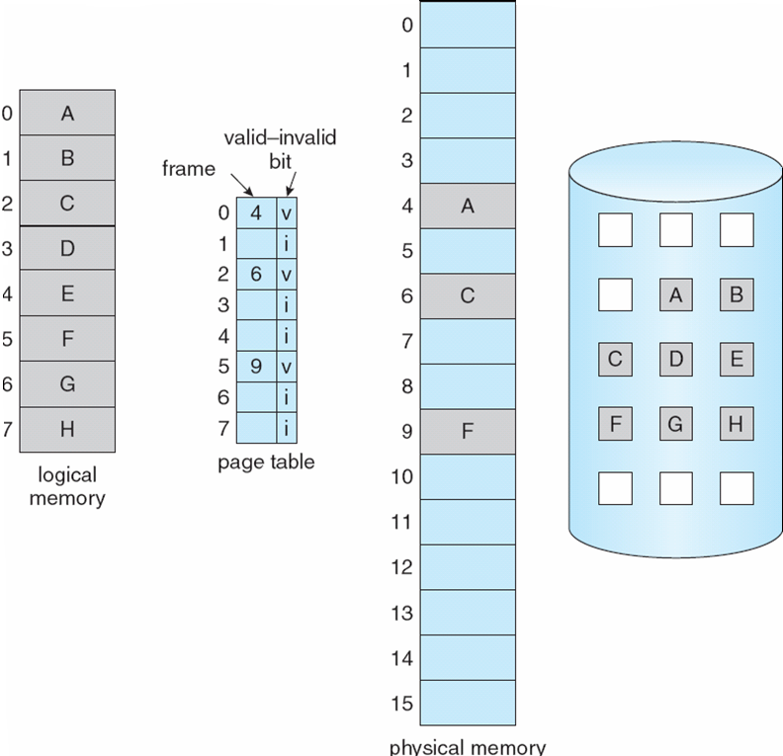

Slide 8

Page Fault
Access to a page marked invalid causes a page-fault trap.

Slide 9
Page Fault
A page fault may occur at any memory reference.
If the page fault occurs on the instruction fetch, we can restart by-fetching the instruction again.
If a page fault occurs while we are fetching an operand, we must fetch and decode the instruction again and then fetch the operand.

Slide 10
Performance of Demand Paging
effective access time = (1 - p) x ma + p x page fault time.
Memory access time = 200 nanoseconds
Average page-fault service time = 8 milliseconds
EAT = (1 – p) x 200 + p (8 milliseconds)
= (1 – p ) x 200 + p x 8,000,000
= 200 + p x 7,999,800
If one access out of 1,000 causes a page fault, then
EAT = 8.2 microseconds.

Slide 11
Page Replacement
If no frame is free, we find one that is not currently being used and free it.
1. Find the location of the desired page on the disk.
2. Find a free frame:
a. If there is a free frame, use it.
b. If there is no free frame, use a page-replacement algorithm to select a victim frame.
c. Write the victim frame to the disk; change the page and frame tables accordingly.
3. Read the desired page into the newly freed frame; change the page and frame tables.
4. Restart the user process.

Slide 12
Page Replacement
If no frames are free, two page transfers (one out and one in) are required. This situation effectively doubles the page-fault service time and increases the effective access time accordingly.
We can reduce this overhead by using a modify bit (or dirty bit).

Slide 13
Page Replacement Algorithms
Page replacement algorithm.
  FIFO
  Optimal Page replacement
  LRU-Least recently used
  LPU approximation
    Additional Bit reference
    Second Chance algorithm
    Enhanced second Chance algorithm

Slide 14
FIFO Page Replacement
When a page is replaced the oldest page is chosen.
Advantages
  Easy to understand and implement
Disadvantages
  A page which is being accessed quite often may also get replaced because it arrived earlier than those present.

Slide 15
FIFO Page Replacement
No of Frames=3
0 1 2 3 0 1 4 0 1 2 3 4

Slide 16
Belady’s Anomaly
Belady's anomaly is the name given to the phenomenon where increasing the number of page frames results in an increase in the number of page faults for a given memory access pattern. This phenomenon is commonly experienced in
First in first out (FIFO)

Slide 17
3 2 1 0 3 2 4 3 2 1 0 4

Slide 18
FIFO
No. of frames=4
7 0 1 2 0 3 0 4 2 3 0 3 2 3

Slide 19
Optimal
Replace the page that will not be used for the longest period of time.
Advantages:
  Guarantees the lowest possible page fault for a fixed number of frames
Disadvantages:
  Difficult to implement because it requires future knowledge of reference string

Slide 20
Least-Recently Used
LRU chooses the page that has not been used for the longest period of time.
We can think of this strategy as the optimal page replacement strategy looking backward in time, rather than forward.
It is considered to be good page replacement strategy.
How to implement- Requires substantial hardware assistance

